Slide 1
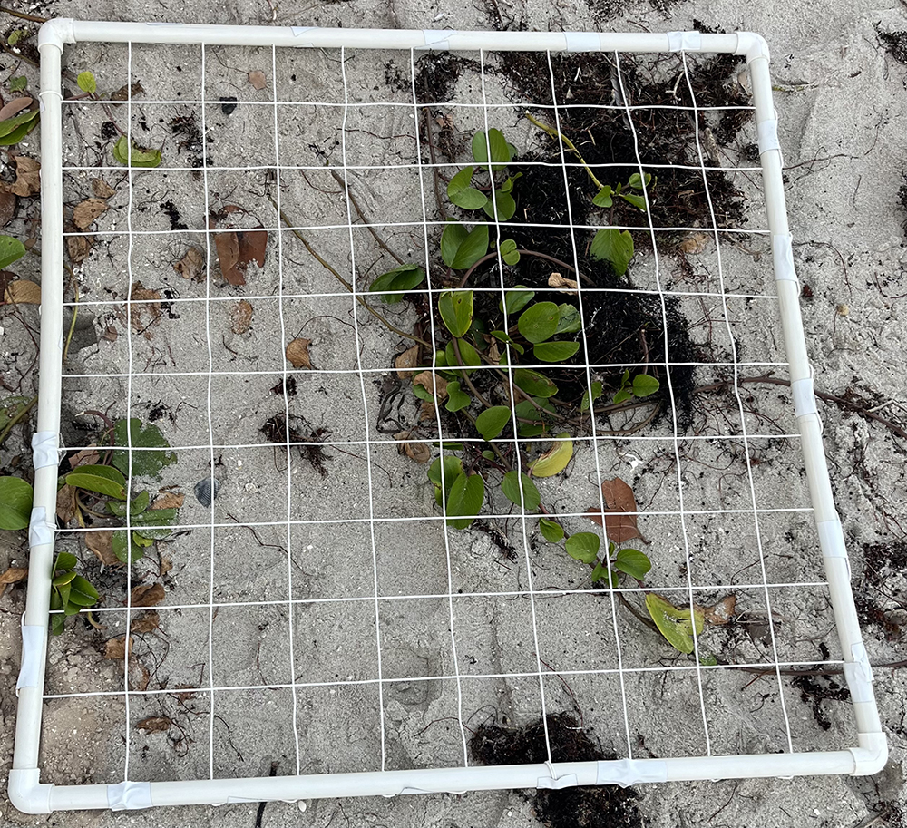
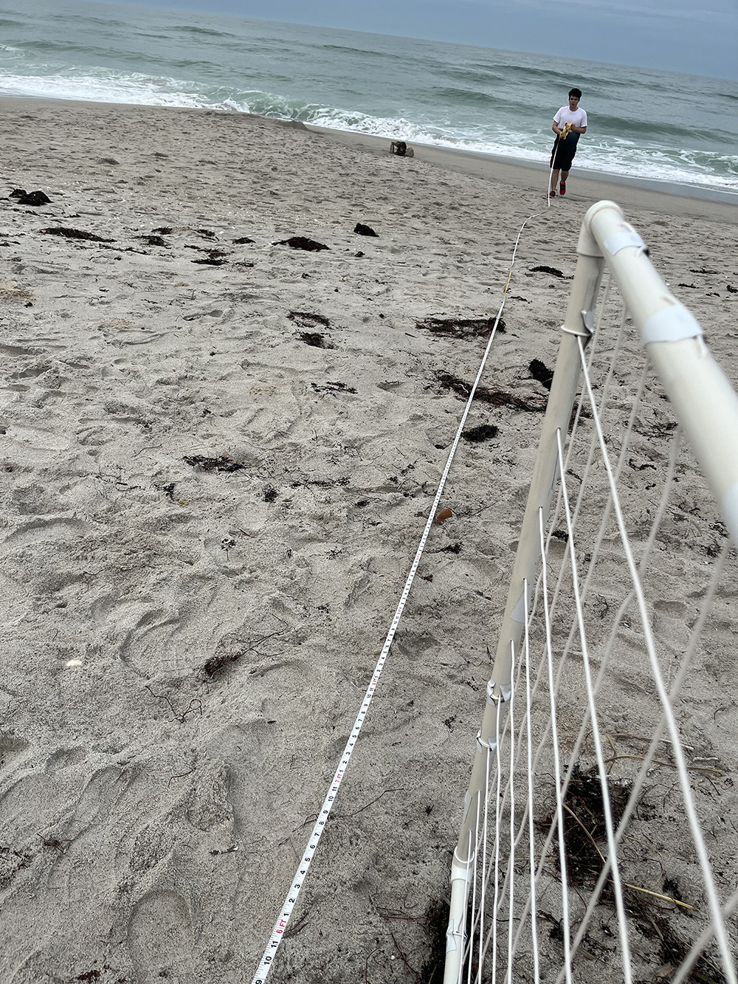
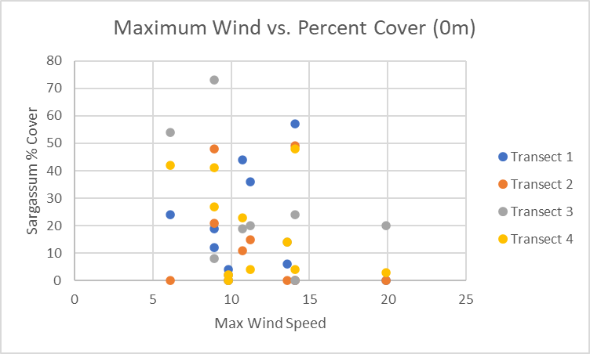
Wind Speed’s Effect on Sargassum Placement on Florida Beaches
Ryan Carstens
Faculty Advisor: Dr. Austin Fox and Dr. Kevin Johnson, Dept. of Ocean Engineering, Florida Institute of Technology
INTRODUCTION
Sargassum serves a vital role in the marine environment because it is a habitat for various migratory organisms; however, too much on beaches can be detrimental. In 2023, a massive sargassum bloom resulted in nesting wildlife, such as sea turtles, being adversely impacted. The invasion of these blooms has been ongoing since 2013. This study looked at the impact of wind on sargassum placement on Florida beaches.
OBJECTIVES
The research hypotheses that guided the study are as follows:
H1. There is a correlation between wind speed and the quantity of sargassum located on Florida beaches.
H2. Wind speed effects sargassum placement on Florida beaches by moving it towards the dunes.
METHODS
Sargassum percent cover was quantified using a standard 1 square meter quadrat placed at 5 m intervals along 4 replicated transect from mean high water to the dune. Data was collected at Pelican Beach, located in Satellite Beach, FL bi-weekly from October 2023 through March 2024. Daily average wind data was retrieved from NOAA at Satellite Beach near Magnolia Street. Regression analysis were carried out to search for relationships between the independent variable, wind speed, and the dependent variable, sargassum % cover.
Figure 1
Data collection Tool and Process
Note. The first image is the data collection tool with 100 equal sized cells to measure the percent of sargassum within different areas. The second image is the researcher measuring the distance from the dunes to the swash zone.
RESULTS
With respect to wind speed and the quantity of sargassum located on Florida beaches, this was not significant (p > 0.05). With respect to wind speed affecting the placement of sargassum on Florida beaches, this was not significant (p > 0.05). Figure 2 displays the average wind speed versus the percent cover of sargassum at 0m to demonstrate no pattern in wind speed affecting sargassum placement.
Figure 2
Maximum Wind Speed vs. Percent Cover of Sargassum
DISCUSSION
Due to the fact that a limited number of past research studies did not focus on wind speed, the current research fills a gap in the literature, but future research studies were identified. First, it is recommended that future research involve data collection on multiple beaches instead of one beach and over longer time periods experiencing a wider range of wind speeds. It is likely that a maximum wind speed of 20 mph was not sufficient to drive sargassum up the beach. Second, the tides are more likely to affect the sargassum placement because the ocean is the origin of the sargassum. Therefore, a future research study should include a focus on how high tide and low tide affects the sargassum quantity.
CONCLUSION
The relationship between wind speed and sargassum placement was not statistically significant. These results indicate that wind speed does not affect the placement of sargassum on Florida beaches. Therefore, the results did not support either hypothesis. Wind speed did not affect sargassum placement on Florida beaches by moving it towards the dunes.
ACKNOWLEDGEMENTS
Debbie Carstens, Lindsay Carstens, Rebecca English, Kevin Johnson, and Darrell Spence

